Slide 1
Software College Northeastern University
Software Testing
Chapter 2 Black-Box Testing
Notes:
功能性测试 数据驱动

Slide 2

Contents
Black-Box Testing
2.1 Introduction
2.2 Equivalence Partitioning
Examples
2.3 Boundary Value Analysis
2.4 Decision Tables
2.5 Cause-Effect Graphing
2.6 Orthogonal Array Testing
2.7 Scenario Testing
Chapter 2

Slide 3

Review-2.1 Black-box testing
An approach to testing where the program is considered as a ‘black-box’.
The program test cases are based on the system specification.
Test planning can begin early in the software process.
software
input
output
Notes:
The advantages of black-box testing:
The test is unbiased because the designer and the tester are independent of each other.
The tester does not need knowledge of any specific programming languages.
The test is done from the point of view of the user, not the designer.
Test cases can be designed as soon as the specifications are complete.
In theory，if black-box testing is used to find program errors, all kinds of possible input conditions and output conditions should be needed. But it is impossible for us to do that.

Slide 4
Review-2.1 Test case
Test Case :
  Input and expected output
  How to run this test case
  More cases or fewer cases?
  We always try to use the fewest cases to test the software product, but the quality can still be guaranteed. How?
Notes:
可重复性。

Slide 5
Review-2.2 Equivalence Partitioning (EP)
valid data and invalid data are needed at the same time
Input data/output results often fall into different classes where all members of a class are related.
Each of these classes is an equivalence partition or domain where the program behaves in an equivalent way for each class member.
For each class, testers only need to select some representative members to design test cases
Notes:
Partition situation
Valid equivalence class
For specification, it is a congregation consists of reasonable and meaningful data.
It can be used to check whether the application realized the predicted functions and performance.
Invalid equivalence class
For specification, it is a congregation consists of unreasonable and meaningless data.
It can be used to check whether the invalid data is handled correctly.

Slide 6
Review-2.2 Test case design under different constraints
Weak
(single defect)
Traditional
/Normal
(valid)
Strong
(mult. defect)
Robust
(valid&invalid)
Strong robust
Weak traditional
Strong traditional
Weak robust
Notes:
弱：只单缺陷假设。
强：多缺陷假设。
一般：考虑有效值。
健壮：考虑无效值。

Slide 7
Review-2.2 Test case design (EP)
F(x₁,x₂)
  Two sub-domains [e,f) and [f,g] for x₁
  Three sub-domains [a,b), [b,c) and [c,d] for x₂
x₁
g
f
e
x₂
0
a
b
c
d
Notes:
单缺陷假设：可靠性理论中的一个关键假设，假设失效极少是由2个或多个缺陷同时发生引起的

Slide 8
2.2.1 Test case design (EP)
Weak traditional partitioning
x₁
g
f
e
x₂
0
a
b
c
d
Notes:
确保每个变量的等价划分至少有一个被覆盖即可，要是有多个，也行；所谓单缺陷，即某个变量的等价类内部，只能有一个引发故障。
Weak traditional partitioning
Single defect assumption: failures are very rarely caused by the simultaneous occurrence of two (or more) defects.
Test cases: should cover all valid equivalence classes for each variable
每一个sub-domain，选择一个即可。对于[e,f]确实多了一个，没有办法

Slide 9
2.2.2 Test case design (EP)
Strong traditional partitioning
x₁
g
f
e
x₂
0
a
b
c
d
Notes:
Strong traditional partitioning
multiple defects assumption: the opposites of the single defect assum.
Test cases: should cover all elements in the Cartesian Product of Valid Equivalence Classes of each input variable

Slide 10
2.2.3 Test case design (EP)
Weak robust partitioning (default)
x₁
g
f
e
x₂
0
a
b
c
d
Notes:
确保每个变量的等价划分至少有一个被覆盖即可，要是有多个，也行；所谓单缺陷，即某个变量的等价类内部，只能有一个引发故障。
Weak robust partitioning
Single defect assumption: failures are very rarely caused by the simultaneous occurrence of two (or more) defects.
Test cases: should cover all valid&invalid equivalence classes for each variable

Slide 11
2.2.3 Test case design (EP)
More input variables?
Strong robust partitioning
x₁
g
f
e
x₂
0
a
b
c
d
Notes:
Strong robust partitioning
multiple defects assumption: the opposites of the single defect assum.
Test cases: should cover all elements in the Cartesian Product of Valid&Invalid Equivalence Classes of each input variable

Slide 12
2.2.3 Test Case Design (EP)
By default: weak robust partitioning
  Find out all input variables
  For each input variable, valid equivalence class and invalid equivalence class should be included
  Assign a unique No. for each valid EC or invalid EC
  Design a test case for each EC
Input variables | Valid Equivalence Class(EC) | Invalid EC
Input-1 | （1）EC1 | （4）EC3
 | （2）EC2
Input-2 | （3）…… | （5）……
Notes:
对每一个输入条件划分等价类，要包含有效和无效的等价类。并为每一个等价类规定唯一编号。

Slide 13
2.2.3 Test Case Design (EP)
The steps of design test case
  Find out equivalence classes
  Set up a table and give all equivalence classes
  Every equivalence class has a unique No. (previous slide)
  Design a new test case, try to make it include those exclusive equivalence classes which doesn’t be included now, repeat this step until all valid equivalence classes are included.
  For each invalid equivalence class of each input, design a new test case where all other inputs are valid. Repeat this step until all invalid equivalence classes are included.
Notes:
1 划分等价类，可以根据输出或输入
2 建立表格得到所有等价类
3 判断每一个等价类是否唯一
4 设计一个新的测试用例，使得他包含着这些独一无二的等价类中，重复这一步骤，直到所有的有效等价类全部包括
5设计一个新的测试用例，尽量让他只包括在一个无效等价类，重复此步骤，直到所有的无效等价类。
尽可能多的覆盖有效等价类，只覆盖一个无效等价类

Slide 14
Weak robust partitioning (default)
x₁
g
f
e
x₂
0
a
b
c
d
Notes:
确保每个变量的等价划分至少有一个被覆盖即可，要是有多个，也行；所谓单缺陷，即某个变量的等价类内部，只能有一个引发故障。
Weak robust partitioning
Single defect assumption: failures are very rarely caused by the simultaneous occurrence of two (or more) defects.
Test cases: should cover all valid&invalid equivalence classes for each variable

Slide 15
2.2.4 NextDate Example
Equivalence Class Test Cases for the NextDate Function（ 1812≤year≤2012 ）
  Step 1: find out equivalence classes
    Valid equivalence class：
    M1 = {month：1≤month≤12}
    D1 = {date：1≤date≤31}
    Y1 = {year：1812≤year≤2012}
    Invalid equivalence class：
    M2 = {month：month<1}
    M3 = {month：month>12}
    D2 = {date：date<1}
    D3 = {date：date>31}
    Y2 = {year：year<1812}
    Y3 = {year：year>2012}
Notes:
有效等价类数量等于独立变量数量，这里假设变量之间是独立的。（为什么给这个假设？日月年不独立）
闰年的代码量，80%的活动出现在20%的代码中

Slide 16
2.2.4 NextDate Example
Equivalence Class Test Cases for the NextDate Function（ 1812≤year≤2012 ）
  Step 2: design test cases (weak robust)
Test Case ID | month | day | year | Expected Output
WR1 | 6 | 15 | 1912 | 1912.6.16
WR2 | -1 | 15 | 1912 | Invalid Month
WR3 | 13 | 15 | 1912 | Invalid Month
WR4 | 6 | -1 | 1912 | Invalid Day
WR5 | 6 | 32 | 1912 | Invalid Day
WR6 | 6 | 15 | 1811 | Invalid Year
WR7 | 6 | 15 | 2014 | Invalid Year
Notes:
有效等价类数量等于独立变量数量，这里假设变量之间是独立的。（为什么给这个假设？日月年不独立）
闰年的代码量，80%的活动出现在20%的代码中

Slide 17
2.2.4 NextDate Example
Test cases for Strong robust equivalence classes (Some cases)
Test case ID | month | date | year | Expected output
SR1 | -1 | 15 | 1912 | Invalid input
SR2 | 6 | -1 | 1912 | Invalid input
SR3 | 6 | 15 | 1811 | Invalid input
SR4 | -1 | -1 | 1912 | Invalid input
SR5 | 6 | -1 | 1811 | Invalid input
SR6 | -1 | 15 | 1811 | Invalid input
SR7 | -1 | -1 | 1811 | Invalid input
Notes:
健壮是指要考虑无效值，强是指多缺陷假设。
一部分，三维立方的一个角
实际上，还得考虑month>12的，等等。很复杂

Slide 18
Contents
Black-Box Testing
2.1 Introduction
2.2 Equivalence Partitioning
Examples
2.3 Boundary Value Analysis
2.4 Decision Tables
2.5 Cause-Effect Graphing
2.6 Orthogonal Array Testing
2.7 Scenario Testing
Chapter 2

Slide 19
2.3 Boundary Value Analysis
Boundary value analysis focuses on the boundary of the input space to identify test cases.
The main idea behind boundary value testing is that errors tend to occur near the extreme values of an input variable.
Notes:
边界值分析关注的是输入空间的边界，以标志测试用例。背后的基本原理是错误更可能出现在输入变量的极值附近。
边界值分析方法是对等价类划分方法的补充。输入输出的等价类边界就是应当着重测试的边界情况。

Slide 20
2.3.1 Examples of Boundary Values
An integer with 16 bits: 32767 and -32768
Elements in an array: the first one and the last one
A loop condition like “for (i=0; i<100; i++)”: 0 and 99
Notes:
边界值分析关注的是输入空间的边界，以标志测试用例。背后的基本原理是错误更可能出现在输入变量的极值附近。
边界值分析方法是对等价类划分方法的补充。输入输出的等价类边界就是应当着重测试的边界情况。

Slide 21
2.3.2 Test Case Design
Find the boundary values (boundary of equivalence classes)
Use the boundary values instead of random or typical values as the inputs of test cases
Notes:
边界值分析关注的是输入空间的边界，以标志测试用例。背后的基本原理是错误更可能出现在输入变量的极值附近。
边界值分析方法是对等价类划分方法的补充。输入输出的等价类边界就是应当着重测试的边界情况。

Slide 22
2.3.2 Test Case Design
Basic idea:
  Five points: use input variable values at their minimum (min), just above the minimum (min+), a nominal value (nom), just below their maximum (max-), and at their maximum (max)
min
min+
nom
max-
max
Notes:
边界值分析的基本思想是使用极小值，略高于极小值，正常值，略低于最大值，最大值

Slide 23
2.3.2 Single Input Variable
How to select boundary values for a single input variable:
  Example: For desks with length from 10 m to 20 m, …
  nominal value (nom): 15 m
  boundary values: 10, 10.01, 19.99, 20
Notes:
边界值分析的基本思想是使用极小值，略高于极小值，正常值，略低于最大值，最大值

Slide 24
2.3.2 Multiple Input Variables
How to select boundary values for multiple input variables:
  1) The value of the selected input variable changes from min, min+, nom, max- to max, while values of other input variables are fixed as nom.
  2) Repeat 1) for each input variable.
Notes:
边界值分析的基本思想是使用极小值，略高于极小值，正常值，略低于最大值，最大值

Slide 25
2.3.2 An Example
Function F(x₁, x₂)
a≤x₁≤b, c≤x₂≤d
Test cases based on boundary value analysis (five points)

Slide 26
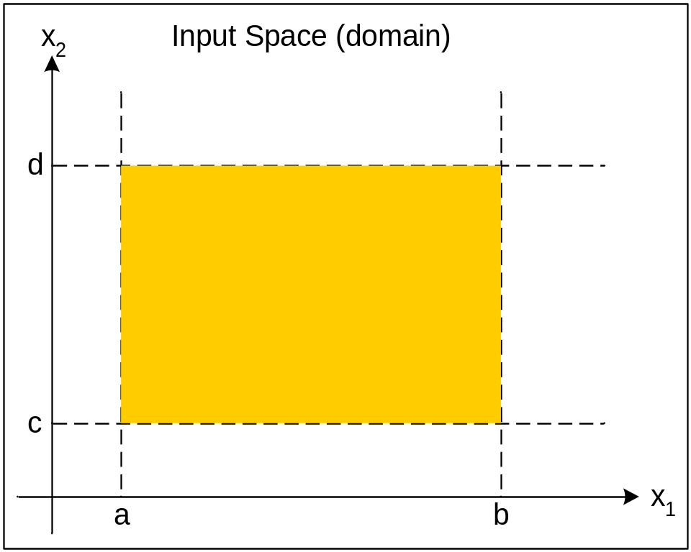
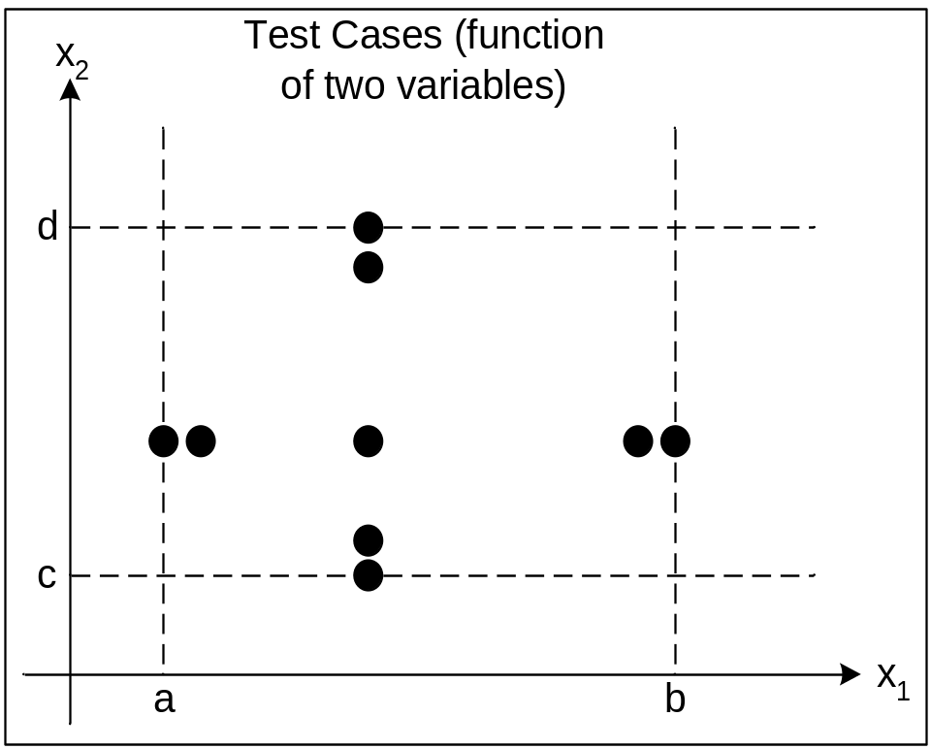
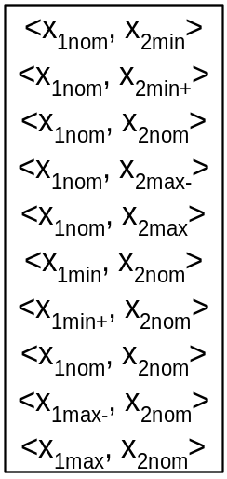
2.3.2 An Example

Slide 27
2.3.2 Summary
Given a function f(x,y) with two input variables x and y. x and y are integers, and x∈[1,12], y∈[1,31]. Then test cases (five points) include:
  { <1,15>, <2,15>, <11,15>, <12,15>, <6,15>, <6,1>, <6,2>, <6,30>, <6,31> }
In general, given a function with n input variables, the number of test cases is 4n+1.

Slide 28
2.3.2 Summary
Given a function f(x,y,z) with three input variables x, y, and z. All inputs are integer and x∈[1900,2100], y∈[1,12], z∈[1,31]. Then the test cases are listed as below:
  { <2000,6,1>, <2000,6,2>, <2000,6,30>, <2000,6,31>, <2000,1,15>, <2000,2,15>, <2000,11,15>, <2000,12,15>, <1900,6,15>, <1901,6,15>, <2099,6,15>, <2100,6,15>, <2000,6,15> }

Slide 29
2.3.3 Robust Testing (Seven Points)
Basic idea:
  Five points: use input variable values at their minimum (min), just above the minimum (min+), a nominal value (nom), just below their maximum (max-), and at their maximum (max)
  Seven points: additionally add two points: just below the minimum (min-) and just above their maximum (max+)
min
min+
nom
max-
max
min-
min
min+
nom
max-
max
max+
Notes:
边界值分析的基本思想是使用极小值，略高于极小值，正常值，略低于最大值，最大值

Slide 30
2.3.3 Robust Testing
Robust Testing
  Simple extension of boundary value analysis
  A value slightly greater than the maximum (max+) and a value slightly less than the minimum (min-)
  Focus on how to handle the exception input
Notes:
健壮性测试是边界值分析的简单扩展
除了边界值分析的取值外，还要考虑略高于最大值，和略小于最小值
关注这个时候的输出
价值在于例外情况的处理

Slide 31
2.3.3 Robust Testing
In general, given a function with n input variables, the number of test cases is (4+2)n+1.

Slide 32
2.3.3 An Example
Function F(x₁, x₂)
a≤x₁≤b, c≤x₂≤d
Test cases based on boundary value analysis (five & seven points)

Slide 33
2.3.3 An Example
x2
x2
c
c
d
d
a
b
x1
a
b
x1
five points
seven points

Slide 34
2.3.3 Another Example
Given a function f(x,y) with two input variables x and y. All inputs are integer and x∈[1, 12], y∈[1,31]. Then the test cases based on robust testing are listed as below:
  {<0,15>, <1,15>, <2,15>, <11,15>, <12,15>, <13,15>, <6,0>, <6,1>, <6,2>, <6,30>, <6,31>, <6,32>, <6,15>}

Slide 35
2.3.4 Worst Testing
Boundary Value Analysis (Robust Testing) is based on the Single Defect assumption.
What will happen if multiple variables have extreme values?
Notes:
边界值分析的基本思想是使用极小值，略高于极小值，正常值，略低于最大值，最大值

Slide 36
2.3.4 Test Cases for Worst Testing
Sample five values by “Five Points” for each input variable.
Compute “Cartesian Product” based on all sampled values of all input variables.
Design a test case for every element in the result of Cartesian Product.
In general, given a function with n input variables, the number of test cases is 5^{n}.
Notes:
边界值分析的基本思想是使用极小值，略高于极小值，正常值，略低于最大值，最大值

Slide 37
2.3.4 An Example
x2
c
d
a
b
x1

Slide 38
2.3.4 Worst Testing vs. the basic Boundary Value Analysis (Five Points)
The set of test cases of the latter is the subset of the former.
Worst Testing can completely test the quality of a software product. Of course, the testing work is heavy.
  (4n+1) vs. 5^{n}

Slide 39
2.3.4 Robust Worst Testing
Sample seven values for each input variable based on the “Seven Points” method
x2
c
d
a
b
x1

Slide 40
2.3.5 Boundary Value Analysis
Limitations of Boundary Value Analysis(including Five Points, Robust Testing(Seven Points), Worst Testing)
  Boundary value analysis works well when the program to be tested is a function of several independent variables that represent bounded physical quantities.
  e.g. nextDate test cases are inadequate (little stress on February, dependencies among month, day, and year) 2/29/1996 vs. 2/28/1997
  e.g. variables refer to physical quantities, such as temperature, air speed, load etc. But, goodness---the quality of a person?
Notes:
边界值分析适合于被测试的程序由多个独立的变量组成，且这些变量是有界的物理量
比如二月份的问题，会涉及到expected output的设计

Slide 41
2.3.5 Boundary Value Analysis
Triangle problem (Five Points)
  Three inputs: a、b、c
  1 ≤ a ≤ 200
  1 ≤ b ≤ 200
  1 ≤ c ≤ 200
  a = {1，2，100，199，200}
b = {1，2，100，199，200}
c = {1，2，100，199，200}

Slide 42
2.3.5 Boundary Value Analysis
Triangle problem test case
Test case | A | B | C | Expected output
1 | 100 | 100 | 1 | Isosceles
2 | 100 | 100 | 2 | Isosceles
3 | 100 | 100 | 100 | Equilateral
4 | 100 | 100 | 199 | Isosceles
5 | 100 | 100 | 200 | Not a triangle
6 | 100 | 1 | 100 | Isosceles
7 | 100 | 2 | 100 | Isosceles
8 | 100 | 100 | 100 | Equilateral
9 | 100 | 199 | 100 | Isosceles
10 | 100 | 200 | 100 | Not a triangle
11 | 1 | 100 | 100 | Isosceles
12 | 2 | 100 | 100 | Isosceles
13 | 100 | 100 | 100 | Equilateral
14 | 199 | 100 | 100 | Isosceles
15 | 200 | 100 | 100 | Not a triangle
At minimum
Just above the minimum
Nominal value
Below their maximum
At their maximum
Notes:
边界值分析法是基于单缺陷假设的。
Equilateral ['ikwə'lætərəl]等边形
Isosceles [aɪ‘sɑsə’liz] 二等边形

Slide 43
2.3.5 Boundary Value Analysis
NextDate function problem
  NextDate is a function has three variables (month, date, and year), it return the next date which user input. Month, date and year are all integer, and satisfy these conditions below:
    1 ≤ month ≤ 12
    1 ≤ date≤ 31
    1812 ≤ year ≤ 2012
    month = {1，2，6，11，12}
date = {1，2，15，30，31}
year = {1812，1813，1912，2011，2012}

Slide 44
2.3.5 Boundary Value Analysis
Next Date function test case
Test case | month | date | year | Expected output
1 | 6 | 15 | 1812 | 6/16/1812
2 | 6 | 15 | 1813 | 6/16/1813
3 | 6 | 15 | 1912 | 6/16/1912
4 | 6 | 15 | 2011 | 6/16/2011
5 | 6 | 15 | 2012 | 6/16/2012
6 | 6 | 1 | 1912 | 6/2/1912
7 | 6 | 2 | 1912 | 6/3/1912
8 | 6 | 15 | 1912 | 6/16/1912
9 | 6 | 30 | 1912 | 7/1/1912
10 | 6 | 31 | 1912 | Invalid input
11 | 1 | 15 | 1912 | 1/16/1912
12 | 2 | 15 | 1912 | 2/16/1912
13 | 6 | 15 | 1912 | 6/16/1912
14 | 11 | 15 | 1912 | 11/16/1912
15 | 12 | 15 | 1912 | 12/16/1912
At minimum
Just above the minimum
Nominal value
Below their maximum
At their maximum

Slide 45
Keystone
What is black-box testing?
Guidelines for generating equivalence classes for variables
How to design test case using equivalence classes method?
What is Boundary Value Analysis?

Slide 46
Thank you !

